Slide 1
JavaScript
Sachin Varma

Slide 2
Agenda
Introduction to JavaScript
Data Types
Operators
Looping Structure
Variable Scopes
Hoisting
Objects
Functions
Prototypes and Prototypal Inheritance
Arrays
Event Handling
ES6 – Features

Slide 3
Introduction
1992
Oak, James Gosling @ Sun Microsystems
1995
HotJava - Not going to work in browsers, it's clumsy and way too far from a language that can run on a browser
LiveScript, Brendan Eich at Netscape - First language to be put into web browser
Sun (Java) vs Netscape (Live script) vs Microsoft
Coming together the name given to the language which can work on browsers was "JavaScript"
1996
JScript @ Microsoft ~ Netscape's JavaScript
J++ @ Microsoft ~ Sun's Java
1998
ECMAScript (European Computer Manufacturers Association)

Slide 4
Features
Why JavaScript
Freely Available
Functional Language
Higher-order functions
Recursion
Structured Programming
Reusability
Functional programs are often shorter and easier to understand
Loose Typing
Any variable is capable of receiving any value
Variable don’t require typed declarations
Object as general container
JavaScript objects are containers for named values, called properties and methods.
Prototypal Inheritance
Objects can be inherited from another object
Its main purpose is to allow multiple instances of an object to share a common property which are defined using the prototype object

Slide 5
Data Types
Number
String
Boolean
True
False
Object
Built-In Objects like Array Object, String Object, Math Object, Date Object
Window, document, Objects created by us
Null
Undefined
Examples

Slide 6
Numbers
NaN
NaN == NaN → result ??
Example
parseInt
The parseInt() function parses a string and returns an integer.
Use radix - used to specify which numeral system to be used
parseFloat
The parseFloat() function parses a string and returns a floating point number.

Slide 7
Boolean
True / False
Falsy values
False
Null
Undefined
“”
0
NaN
Truthy values
All other values including all objects (also, “0”, “false”)

Slide 8
Object
Object
JavaScript objects are containers for named values, called properties and methods.
Name can be any string
Value can be anything except undefined
Example

Slide 9
Reserved
abstract else instanceof super
boolean enum int switch
break export interface synchronized
byte extends let this
case false long throw
catch final native throws
char finally new transient
class float null true
const for package try
continue function private typeof
debugger goto protected var
default if public void
delete implements return volatile
do import short while
double in static with

Slide 10
Operators
Arithmetic Operators
+, -, *, /, %, **, ++, --, Unary plus (+), Unary negation (-)
4 + 2 vs ‘$’ + 4 + 2
+’42’
+’4’ +’2’ vs +’4’ + +’2’
Example
Logical Operators
&& (Logical And) → evaluates second operand only if first is true
|| (Logical Or) → if first operand is truthy, it returns first otherwise second
! (Logical Not)
Example
Equality Operators
== / != vs === / !== (Reason to introduce this)
Example

Slide 11
Looping Structures
Looping Structures
Loops are handy, if you want to run the same code over and over again, each time with a different value.
For loop
While loop
Do…While loop
Switch Statement

Slide 12
Variable Scopes
Local Scope
Variables declared within a JavaScript function, become LOCAL to the function.
Since local variables are only recognized inside their functions, variables with the same name can be used in different functions.
Global Scope
A variable declared outside a function, becomes GLOBAL.
JS has implied Global -- if you forget to declare a variable, JS assumes it to be a global variable.
Function Scope vs Block Scope
If you declare variable anywhere in the function, it is available everywhere in the function
If you declare variable twice in the function → Error??
Variable Hoisting
JavaScript's default behavior of moving declarations to the top of the
current scope
JavaScript Initializations are Not Hoisted

Slide 13
Variable Scopes
foo = 1;
function bar() {
if (!foo) {
var foo = 10;
}
alert(foo);
}
bar();
Result → 1 or 10 ??

Slide 14
Variable Scopes
var a = 1;
function b() {
a = 10;
return;
function a() {}
}
b();
alert(a);
Result → 1 or 10 ??
Example

Slide 15
Hoisting
function foo() {
if (!x) {
var x = 1;
}
return;
var y = 1;
}
------------------------------
function foo() {
var x, y;
if (!x) {
x = 1;
}
return;
y = 1;
}
Note:
Only the declarations are hoisted. Assignments are not hoisted

Slide 16
Hoisting
Note: Function declaration has its body hoisted to the top
Example
The name ‘foo’ is hoisted, but the body is left behind, to be assigned during execution in the example

Slide 17
Objects
JavaScript objects are containers for named values, called properties and methods.
How to Create Object
Delete Property
Defining getters and setters

Slide 18
Objects – comparison
Two variables, two distinct objects with the same properties are not same
Both object will be same when you assign one object reference to another object
Example

Slide 19
Objects – prototype
var person = Object.create(null); // this creates an empty objects
Object.defineProperty(person, 'firstName', {
value: “FName",
writable: true,
enumerable: true,
configurable: true
});
Enumerable: If a value is enumerable, it will show up when enumerating over an object using a for(prop in obj) loop
Writable: If a property is writable, you can replace it.
Configurable: If a property is configurable, you can delete it or change its other attributes.

Slide 20
Objects – prototype
So far, we've talked about objects as simple pairs of keys and values.
In fact, JavaScript objects also have one additional attribute: a link to another object. We call this link the object's prototype.
If you try to look up a key on an object and it is not found, JavaScript will look for it in the prototype.
It will follow the "prototype chain" until it sees a null value. In that case, it returns undefined.
Example

Slide 21
Arrays
Arrays are used to store multiple values in a single variable.
var array-name = [item1, item2, ...];
var testArr1= new Array(item1, item2, ...);
Array methods
Access the array element
Change array element
.sort() - Sorting of the array element
.pop() – Remove last element
.push() – Add element to last
.shift() – Remove first element
.unshift() – Add element at first position
.splice() – Remove/add elements from certain places
Array.isArray(names);
Example

Slide 22
Function
A JavaScript function is a block of code designed to perform a particular task
A JavaScript function is executed when "something" invokes it (calls it)
Syntax
function functionName(parameter1, parameter2, parameter3) { code to be executed; }
functionName(Argument1, Argument2, Argument3); //CALLING FUNCTION
Function parameters are the names listed in the function definition.
Function arguments are the real values received by the function when it is invoked.
Inside the function, the arguments (the parameters) behave as local variables.

Slide 23
Function
Function Definitions
JavaScript functions are defined with the function keyword.
You can use a function declaration or a function expression.
function functionName(parameters) { code to be executed }
var x = function (a, b) {return a * b};
Self-invoking functions in JavaScript (or Immediately Invoked Function Expressions)
(function () { var x = "Hello!!"; // I will invoke myself })();

Slide 24
Function
Function Invocation
The code inside the function will execute when "something" invokes (calls) the function:
When an event occurs (when a user clicks a button)
When it is invoked (called) from JavaScript code
Automatically (self invoked)
The () Operator Invokes the Function
Accessing a function without () will return the function definition
Function Return
When JavaScript reaches a return statement, the function will stop executing.
If the function was invoked from a statement, JavaScript will "return" to execute the code after the invoking statement.
Functions often compute a return value. The return value is "returned"
back to the "caller"

Slide 25
Function
Examples
JavaScript Closures
JavaScript variables can belong to the local or global scope.
Global variables can be made local (private) with closures.
Example
Callback Function
A reference to executable code, or a piece of executable code, that is passed as an argument to other code.
Example

Slide 26
Event Handling
Events
onchange
onclick
ondblclick
onmouseover
onmouseout
onmousemove
onkeydown
onkeyup
onload
onfocus
onblur
ondrag
ondrop
onscroll
onsubmit

Slide 27
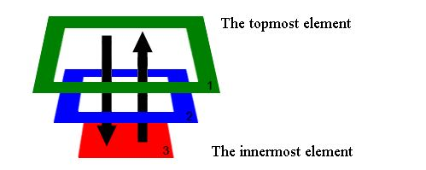
Event Handling
Events
target.addEventListener('click', function() {
alert('Hey, I was clicked!!');
});
target.addEventListener(‘mouseover', function(e) {
e.target.style.backgroundColor = 'yellow';
});
target.addEventListener(‘mouseout', function(e) {
e.target.style.backgroundColor = ‘blue';
});
Example
Event Bubbling & capturing
DOM elements can be nested inside each other. And somehow, the handler of the parent works even if you click on it’s child.
The reason is event bubbling.
event.stopPropagation();
for ie8 and below: event.cancelBubble = true
Example

Slide 28
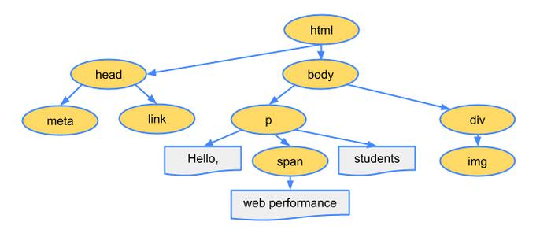
DOM Manipulation
DOM is a platform and language-neutral interface that allows programs and scripts to dynamically access and update the content, structure, and style of a document

Slide 29
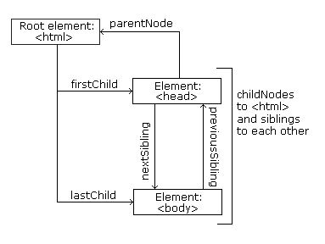
DOM Manipulation
document.getElementById(“id")
document.getElementsByClassName(“name")
document.getElementsByTagName(“name")
element.innerHTML = new html content
element.text = new text
element.attribute = new value
element.setAttribute(attribute, value)
element.style.property = new style
document.removeChild(element)
document.createElement(element)

Slide 30
ES6 – New Features
Some of the highlights:
Classes
Class Inheritance
Base Class Access
Static Members
Template Strings
Modules
Value Export/Import
Constants and Block Scoped Variables
let
CONST
Internationalization and Localization
Number Formatting
Currency Formatting
Date/Time formatting
Default Parameters Values

Slide 31
References
JavaScript: The Good Parts – Douglas Crockford
Learning JavaScript Design Patterns – Addy Osmani
Mozilla Developer Network
http://es6-features.org

Slide 32
Thank You!

